Slide 1
Note
This is the FIRST DRAFT of the slides for the APS presentation. It is now outdated and being kept around for reference/backup. Please use the more recent version

Slide 2
Final Cooling with Thick Wedges for a Muon Collider
Daniel Fu

Slide 3
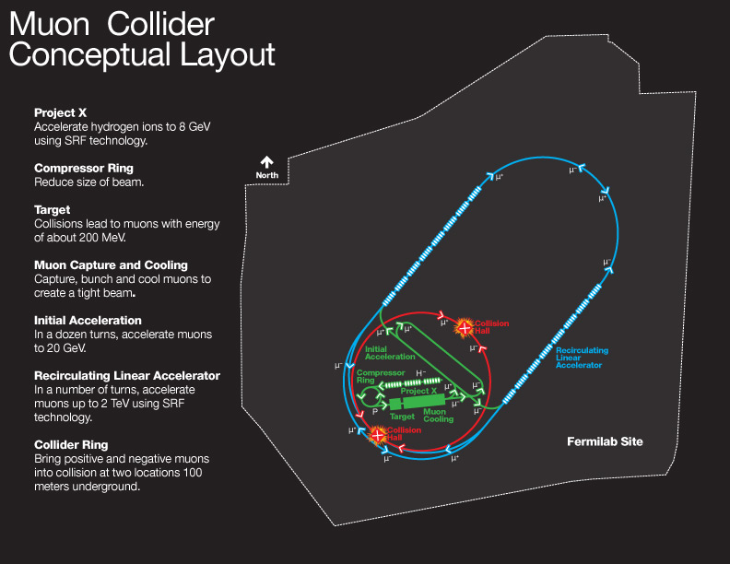
Muon Collider
Proposed particle accelerator colliding positive and negative muons
Muons have advantages over protons or electrons for high-energy physics
Elementary particle (like electrons)
High mass (like protons)
Smaller footprint than other accelerator proposals, such as FCC or ILC

Slide 4
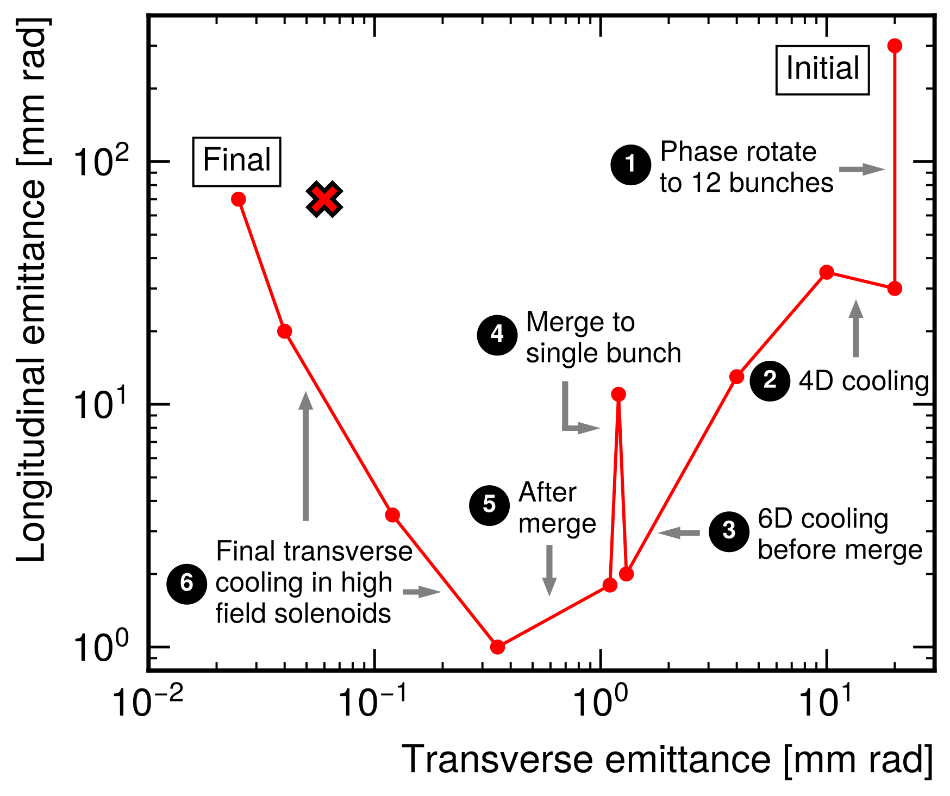
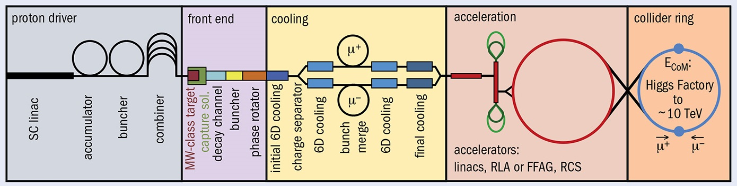
Final Cooling
Proton-target collisions produce muons with high emittance (position/momentum spread)
Emittance must be reduced through cooling
In final cooling, transverse emittance is reduced while longitudinal emittance is allowed to grow

Slide 5
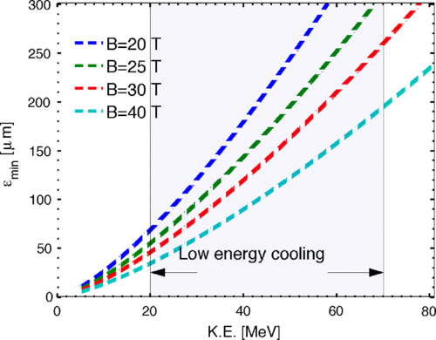
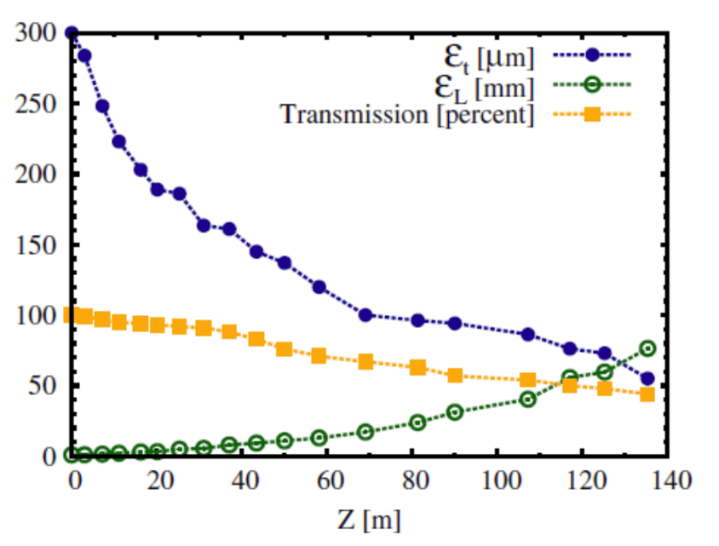
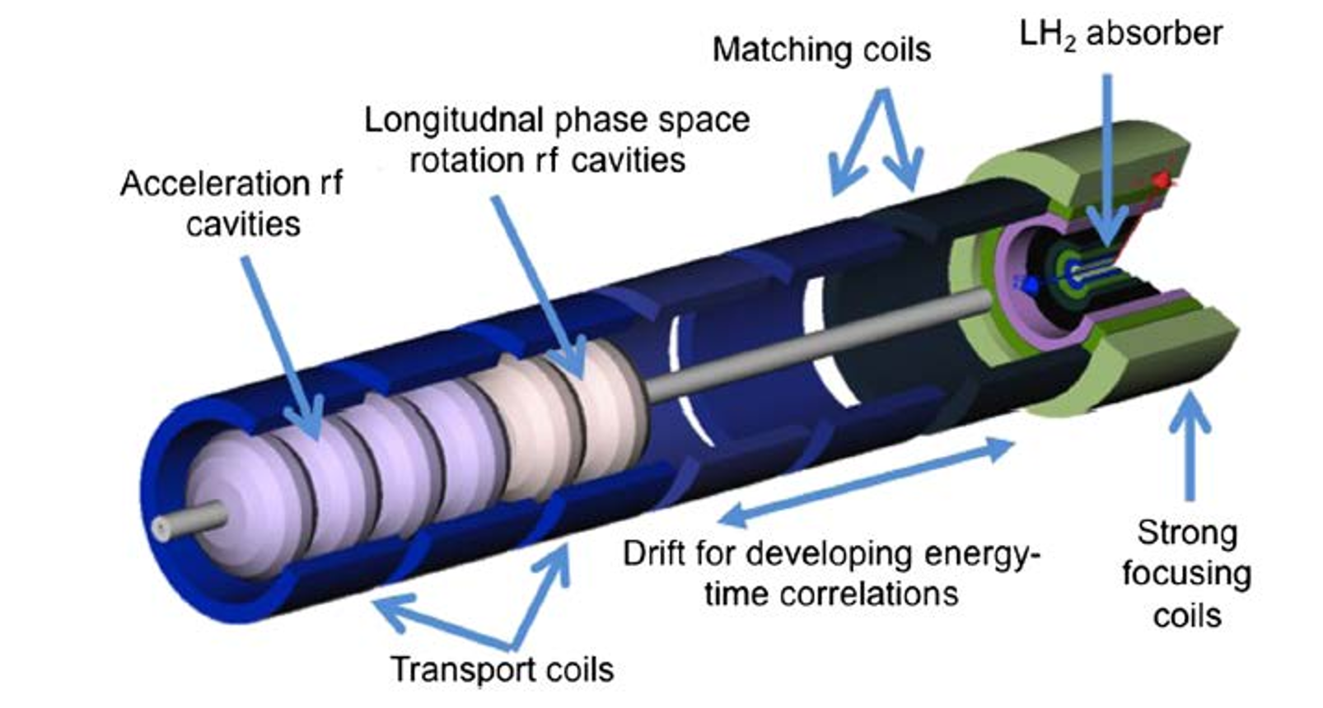
Baseline Final Cooling Scenario
Ionization cooling using high-field solenoids and liquid hydrogen absorbers
Requires impractically strong magnets (40-50 T) and low momentum
Source: 1612.08960

Slide 6
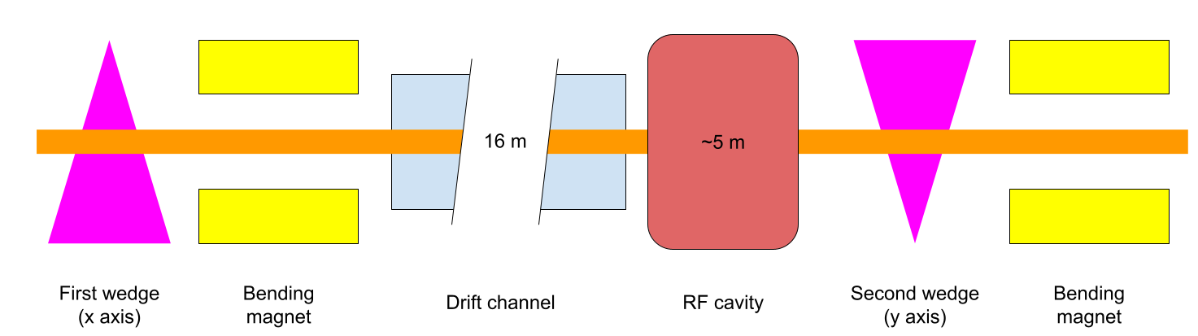
Final Cooling with Thick Wedges
Conceptual final cooling design proposed by Neuffer in 1612.08960
Utilizes wedge-shaped absorbers to achieve emittance exchange
Studied and optimized using G4Beamline simulation software

Slide 7
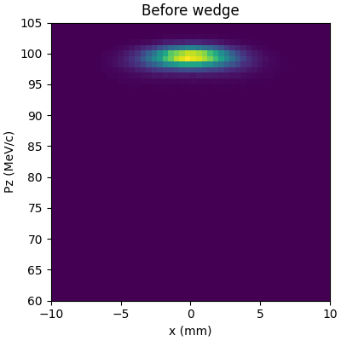
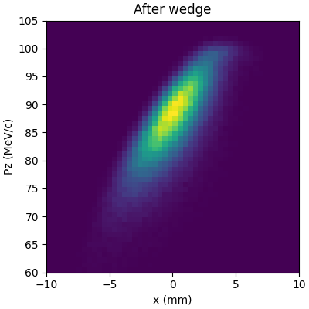
Wedge Absorber
Wedge introduces correlation between x and Pz (dispersion). Spread in Pz is increased as a result

Slide 8
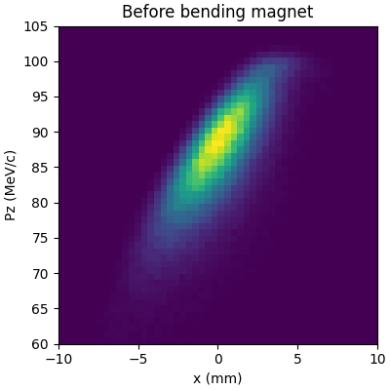
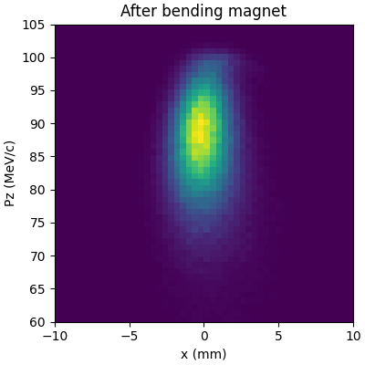
Bending Magnet
Bending (dipole) magnet acts on this correlation to reduce spread in x

Slide 9
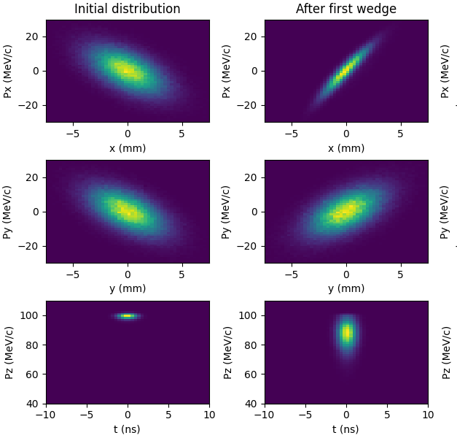
First Wedge
Transverse (x) emittance decreases
Longitudinal emittance increases
Spread in momentum (Pz) must be decreased before second wedge

Slide 10
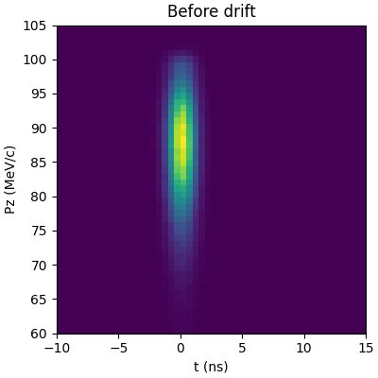
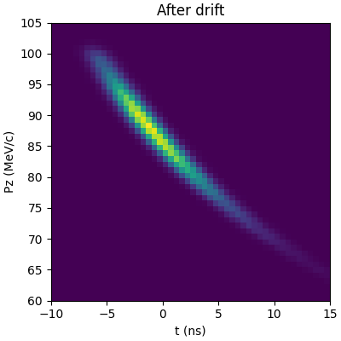
Drift Channel
Particles allowed to travel for a distance to allow correlation to build between z and Pz

Slide 11
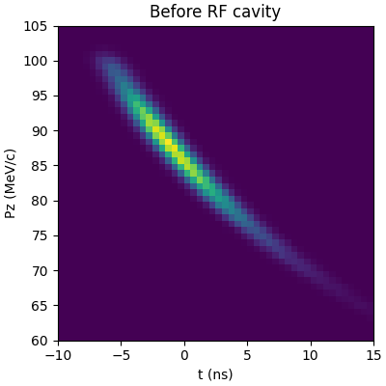
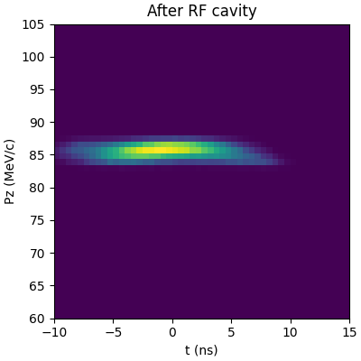
RF Cavity
Time-varying electric field acts on correlation to reduce spread in Pz

Slide 12
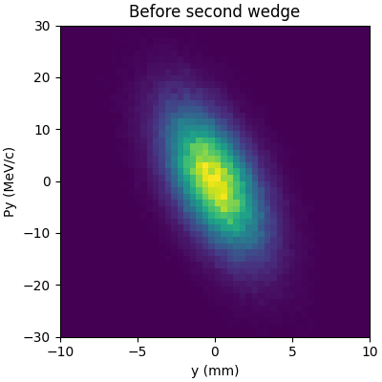
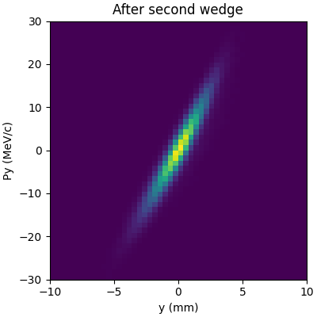
Second Wedge
Process is repeated in the other transverse axis

Slide 13
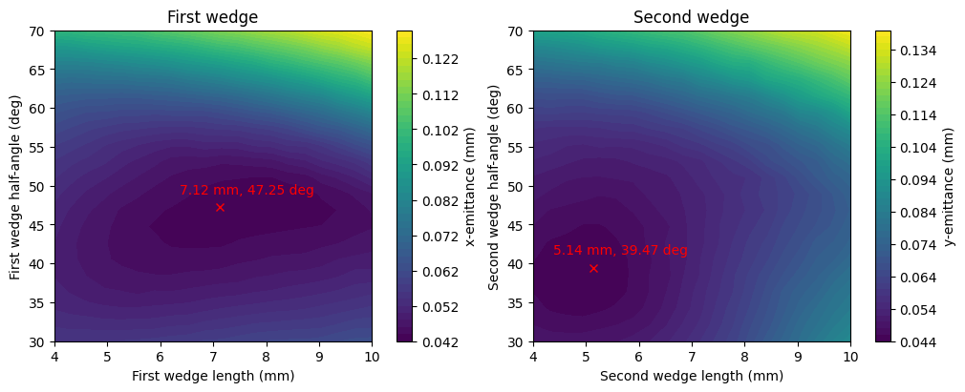
Optimization
Optimization conducted using Nelder-Mead method (Scipy)
Optimized 1st wedge, drift length, RF cavity, and 2nd wedge sequentially

Slide 14
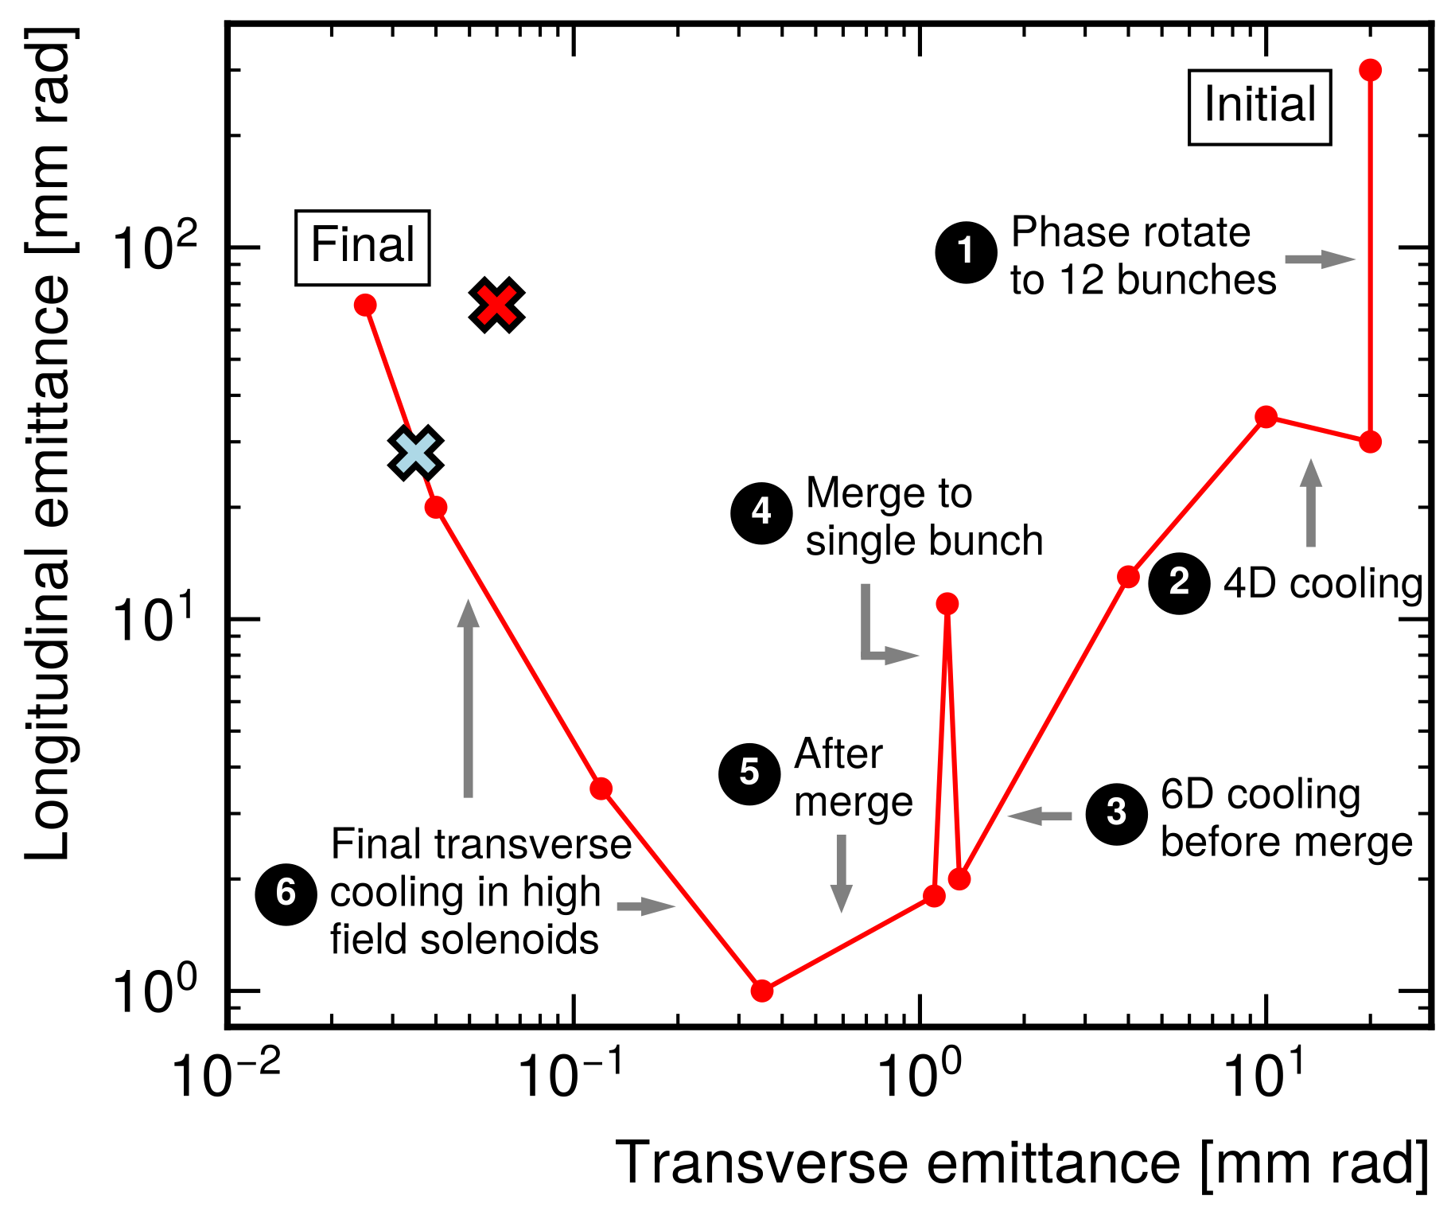
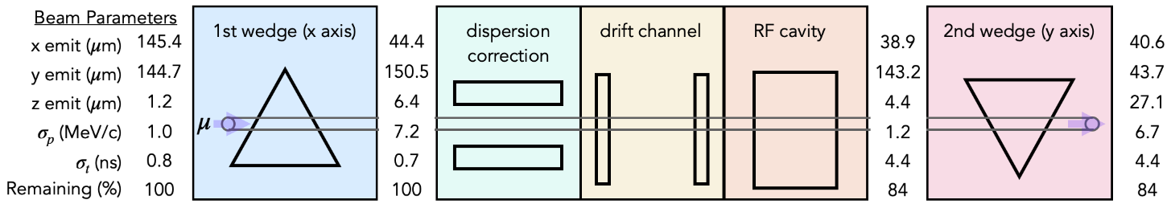
Results
Achieved lower transverse emittance than previous best results
Demonstrated cooling from first and second wedges

Slide 15
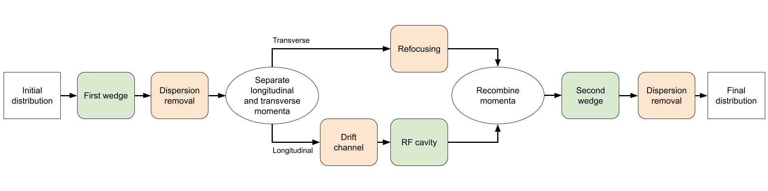
Caveats and Assumptions
Magnets for focusing, beam transport, and bending were not designed – idealized versions assumed
Only longitudinal behavior was considered in the RF cavity
Refocusing before second wedge assumed to be a simple inversion
Figures in previous slide are a best-case scenario

Slide 16
Next Steps
Include magnets in simulation to reduce assumptions
Global optimization using Bayesian methods and surrogate modelling
Validate results v.s. particle count and other parameters
Characterize performance over different input beams
Further optimize design to achieve equal cooling from second wedge

